Slide 1
Banking Customer, Account & Transaction Performance Analysis

Slide 2
Introduction;
This project analyzes a banking dataset containing customers, accounts, transactions, merchants, loans, cards, and branches to derive business insights and support executive decision-making using SQL and Power BI.
Project Objectives;
Analyze customer, account, transaction, merchant, and loan performance.
Develop interactive Power BI dashboards.
Identify trends, risks, and opportunities.
Provide actionable business recommendations.

Slide 3
Dataset Overview
Tables used: Customers (50K), Accounts ( 75K), Transactions (~1M), Loans, Cards, Merchants, and Branches.
Methodology
Data was imported from MySQL into Power BI. SQL was used for KPI analysis and aggregations. DAX measures and calculated columns (Year, Month, Quarter) were created for trend analysis.
Data Preparation
Performed relationship modeling, created derived date columns, validated data types, and developed measures such as Total Customers, Total Transactions, Average Credit Score, Total Loan Amount, and Average Transaction Amount.

Slide 4
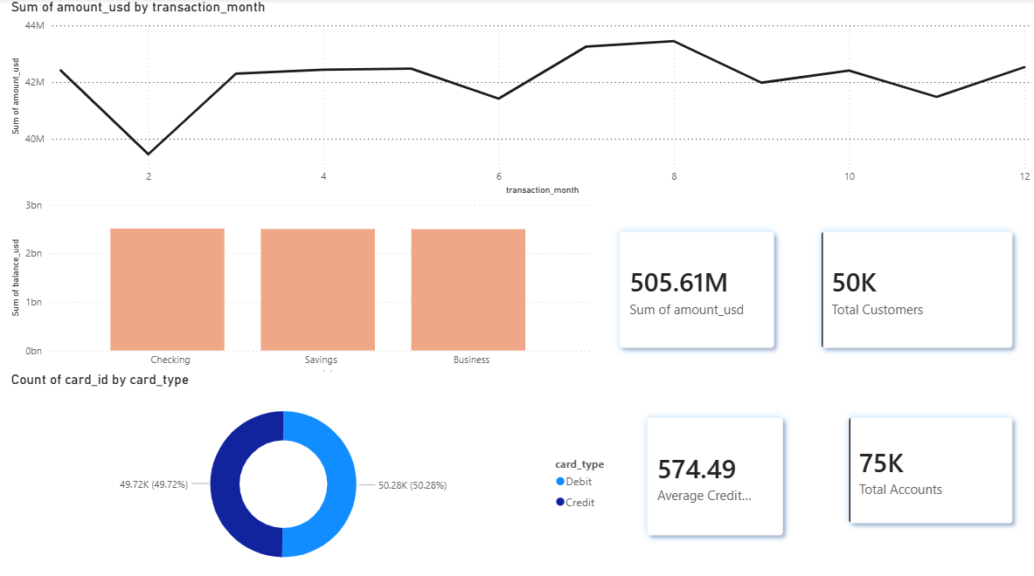
Executive Dashboard ;

Slide 5
Business Insights
The bank serves 50K customers across multiple banking products and maintains 75K active accounts.
Total transaction volume exceeds $505.61M, indicating strong customer engagement and banking activity.
The average credit score of 574.49 suggests a significant portion of customers belong to lower credit segments.
Account ownership is evenly distributed across Checking, Savings, and Business accounts.
Transaction activity remains relatively stable throughout the year, with peaks observed during specific months.

Slide 6
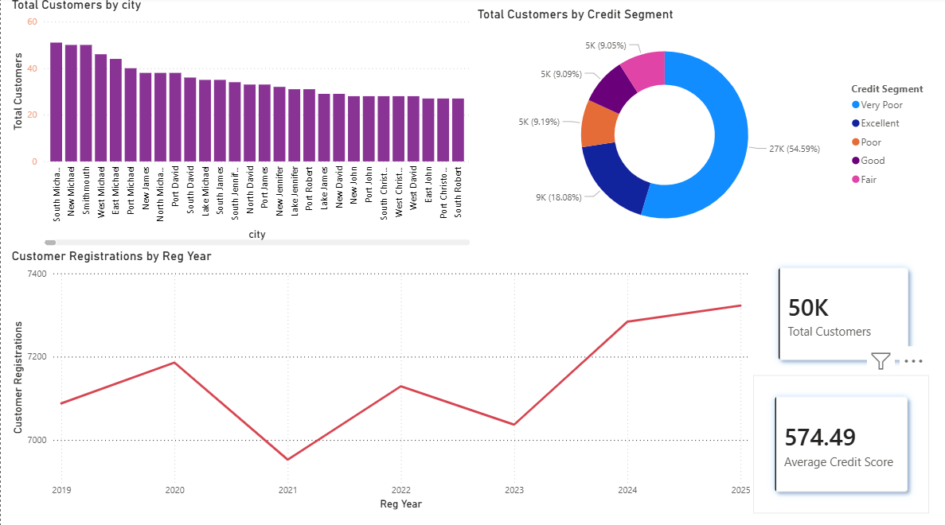
Customers Analytics;

Slide 7
Business Insights;
Customer registrations have shown an upward trend since 2023, indicating effective customer acquisition efforts.
A few cities contribute a major share of the bank's customer base, highlighting key target markets.
More than half of the customers fall under the Very Poor credit score segment, increasing the need for credit risk management.
Customers with better credit profiles present opportunities for premium banking and loan offerings.
Geographic and credit score analysis can help the bank personalize products and improve customer retention.

Slide 8
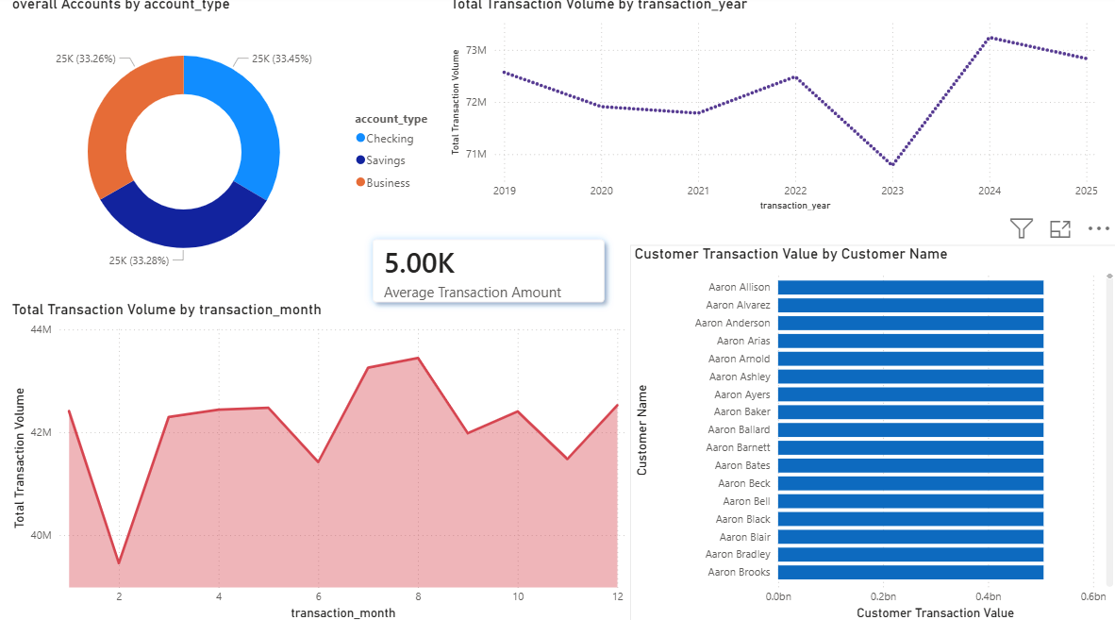
Accounts & Transactions Analytics ;

Slide 9
Business Insights ;
Checking accounts represent the largest share of account ownership among customers.
The bank processes millions of dollars in transactions every month, demonstrating consistent financial activity.
Average transaction amount is approximately $5,000, indicating moderate customer spending behavior.
Transaction values exhibit seasonal trends, which can assist in operational and resource planning.
A small group of customers contributes significantly to overall transaction value, making them ideal candidates for relationship management programs.

Slide 10
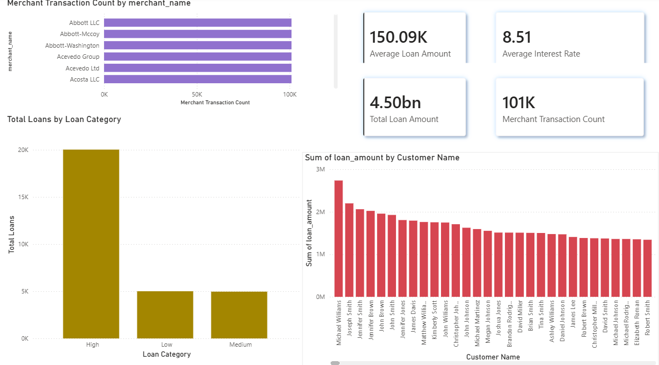
Merchants & Loan Analytics;

Slide 11
Business Insights ;
A limited number of merchants account for the majority of transaction counts, emphasizing their importance to the banking ecosystem.
The loan portfolio exceeds $4.50B, reflecting substantial lending exposure.
High-value loans dominate the portfolio, requiring continuous monitoring to minimize credit risk.
The average interest rate of 8.51% indicates a balanced lending strategy across customer segments.
Top loan customers contribute a significant portion of the total loan amount, suggesting the need for focused portfolio management.

Slide 12
KPI Overview ;
Total Customers: 50K
Total Accounts: 75K
Total Transaction Volume: 505.61M
Average Credit Score: 574.49
Average Transaction Amount: 5K
Total Loan Amount: 4.50B
Average Loan Amount: 150.09K
Average Interest Rate: 8.51

Slide 13
Business Recommendations;
Implement personalized banking strategies for high-value customers to improve retention and customer satisfaction.
Strengthen credit risk monitoring and adopt data-driven lending practices to maintain a healthy loan portfolio.
Leverage customer analytics to identify cross-selling opportunities and increase banking product adoption.
Expand partnerships with top-performing merchants to drive transaction growth and enhance customer engagement.
Utilize transaction and customer trends to support strategic planning, operational efficiency, and sustainable business growth.

Slide 14
THANK YOU
Name

